Slide 1
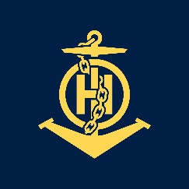
Ms
IHO – NIPPON FOUNDATION
ALUMNI SEMINAR
Ida Lyana Binte Kamsani

Slide 2
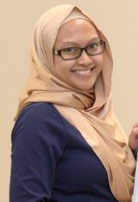
Self introduction
IHO – NIPPON FOUNDATION
ALUMNI SEMINAR
Name | Ida Lyana Binte Kamsani
Alumni year | 2015
Country | Singapore
Organization | Maritime Port & Authority Singapore
Position/Job title | Technical Executive
Current job description | To produce and maintain paper & electronic navigational charts

Slide 3
My career path and projects / Achievements
IHO – NIPPON FOUNDATION
ALUMNI SEMINAR
Cartographer – Paper and ENC chart compiler/checker
Trainer – Basic Cartography Course trainer for new officers

Slide 4
Lessons learned from CHART Course
IHO – NIPPON FOUNDATION
ALUMNI SEMINAR
Data analysis
Basic chart scheming
Chart production from ENC to Paper
Notes:
When I attended CHART Course in 2015, I was still new into the job. My task then was to extract and compile data that has already been analysed. During the course, I learnt how to analyse new data upon receipt. After my return to Singapore, I was put into the Notices to Mariners team where we analyse and decide the variouse course of actions for each data (whether or not to be promulgated into NM or not).

Slide 5
Suggestion for the future
IHO – NIPPON FOUNDATION
ALUMNI SEMINAR
During the course, all our course materials are based on information and practices done in the UK. While it is a good exposure for us to know and use information that is out of the norm, I think it will also be beneficial for us to be working on information that we actually see and use in our daily course of work.
For instance, the topic on Chart Text & Styles are not fully applicable to us as we do not have all the fonts that UKHO uses. UKHO uses blue contours while we don’t. UKHO has various levels of rounding rules for depth sounding while we don’t, we retain or truncate.

Slide 6
Suggestion for the future
IHO – NIPPON FOUNDATION
ALUMNI SEMINAR
My suggestion is to add an additional module where we apply cartographic skills based on information and practices that we use back in our own organizations. Perhaps this way, we are able to relate and apply these skills better in our daily course of work when we return to work.

